Slide 1

Start your Gold DofE

Slide 2
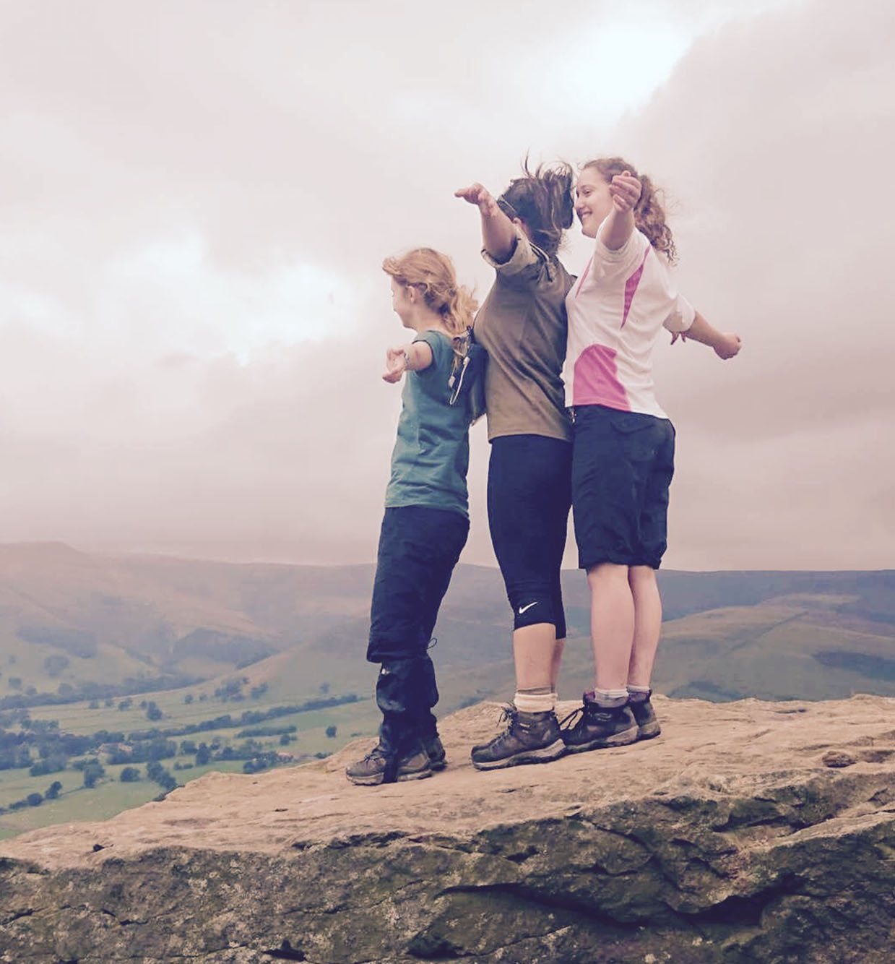
What is the DofE?
GOLD
The DofE is a life-changing adventure you don’t want to miss.
It’s about going the extra mile ­– learning new skills for work and life, getting fitter, helping others and exploring the countryside.
Millions of young people in the UK have already done their DofE.
Now it’s your turn.

Slide 3

What is the DofE? (video)
GOLD

Slide 4
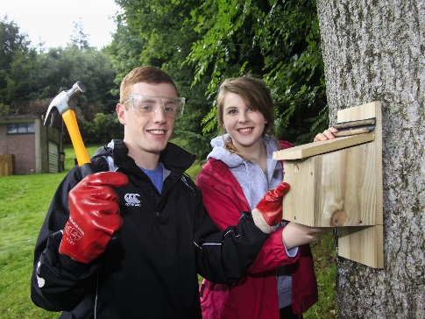
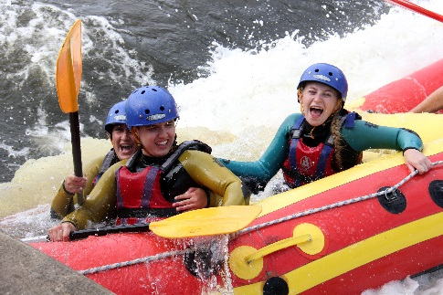

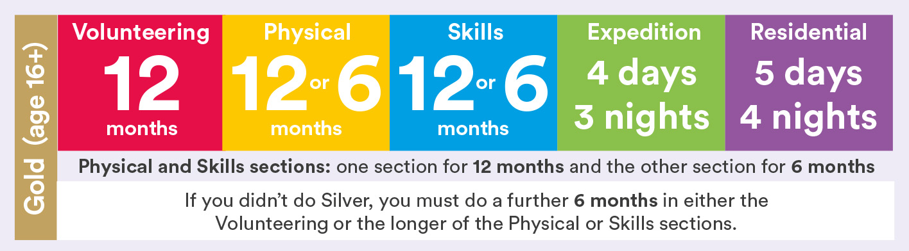
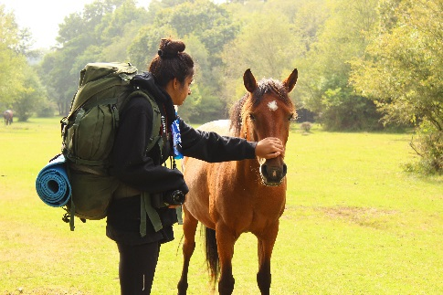
How do I choose my activities?
GOLD
There’s loads to choose from ­­— most activities can count towards your DofE.
Maybe you want to try something new? Or get better at something you’re already doing? Your DofE can be whatever you want it to be.
Activities for each DofE section take a minimum of one hour a week over a set period of time, so they can fit in around your studies and life outside school.

Slide 5
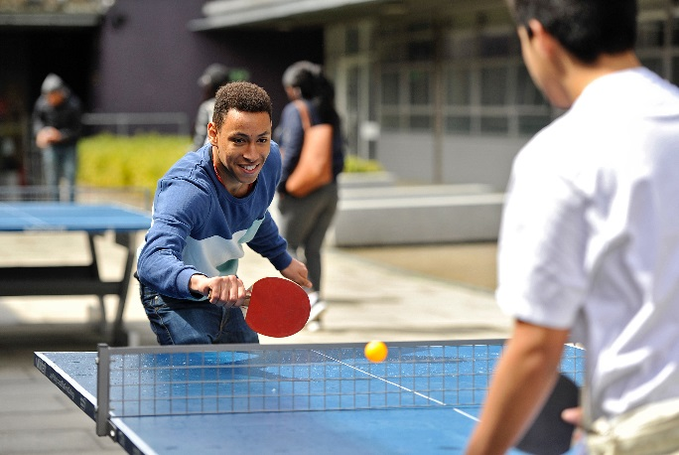
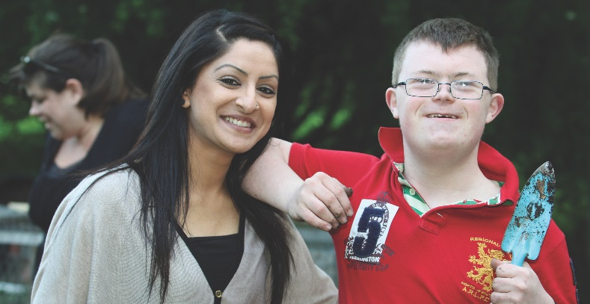

What will you do?
GOLD
Volunteering
Physical
Volunteering’s all about making a difference to others’ lives.
You can choose the cause that means most to you.
From coaching a local football team to starting a recycling campaign, you’ll give up your time to change things for the better.
It’s extremely rewarding — and it can give you the chance to experience the world of work.
The Physical section is a chance for you to focus on your health and fitness — and have fun along the way.
Try something different or concentrate on something you already do. From Zumba to football, skateboarding to walking — almost any dance, sport or fitness activity can count.
You can join a team or do it on your own. It’s up to you.

Slide 6

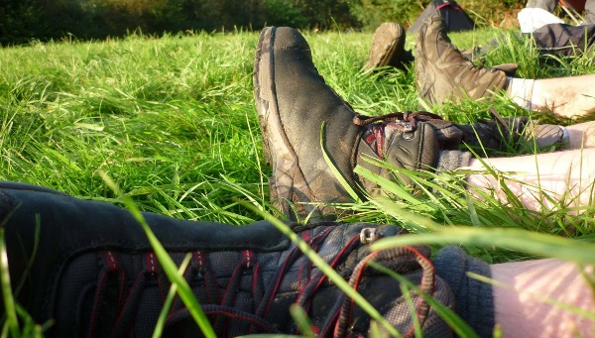
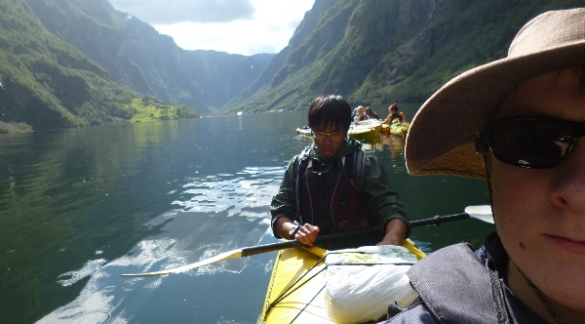
What will you do?
GOLD
Skills
Expedition
From podcasting to playing an instrument, the Skills section lets you learn a new talent, develop existing skills and find something you love doing.
If you’re interested in a specific field, this could be the perfect chance to do something related to it. If you’re interested in cooking, for example, you could do that as your skill.
You’ll grow in confidence and get a real sense of achievement.
Your expedition will give you lifelong memories.
With a team of friends, you’ll plan your aim, choose your location and do some training to make sure you’re prepared — then spend four days and three nights away.
You can choose how you travel. You could do it on foot, by bike, canoe, kayak, wheelchair, sailing boat or even on horseback.

Slide 7
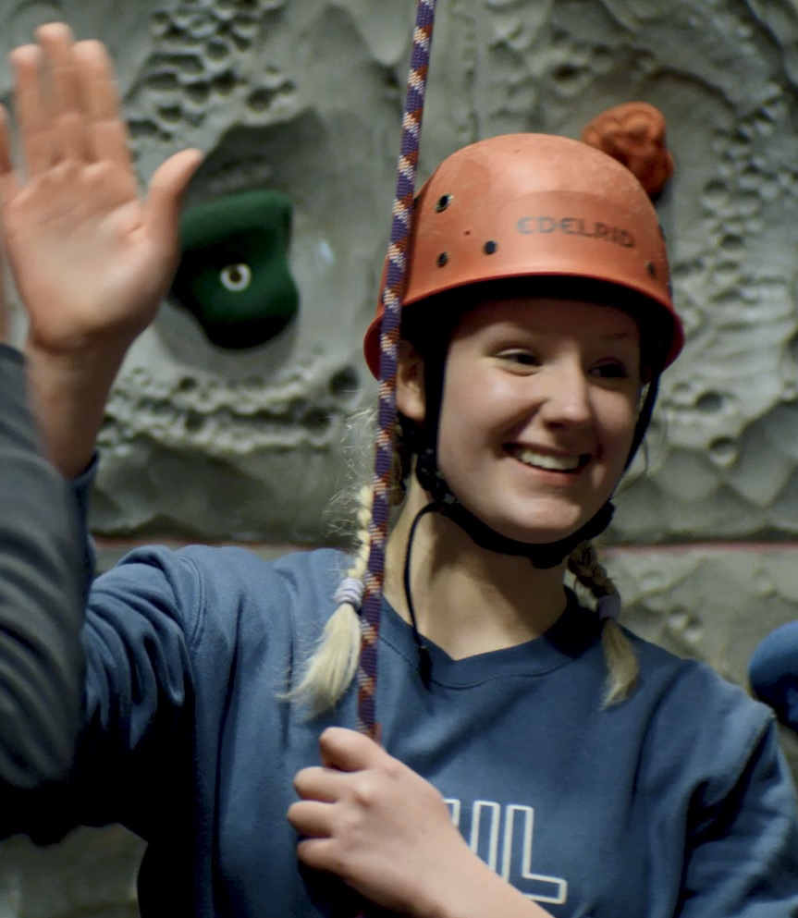
Residential
GOLD
To achieve your Gold Award, you need to complete an extra section – the Residential.
It’s a big, exciting and fulfilling experience, spending five days and four nights away from home on a shared activity with people you’ve never met before.
From learning to snowboard in Scotland to helping at a children’s camp, there are lots of exciting possibilities for you to get involved with — both in the UK and abroad.
You’ll learn how to work with people from different backgrounds and build confidence staying in new environments.
You may want to build on a talent you’ve developed in another section, learn something completely new on an intensive course or do something to help others.

Slide 8
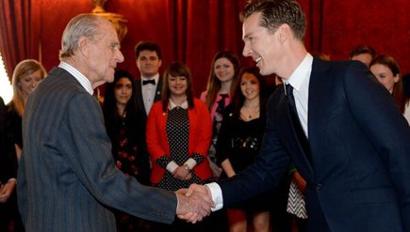
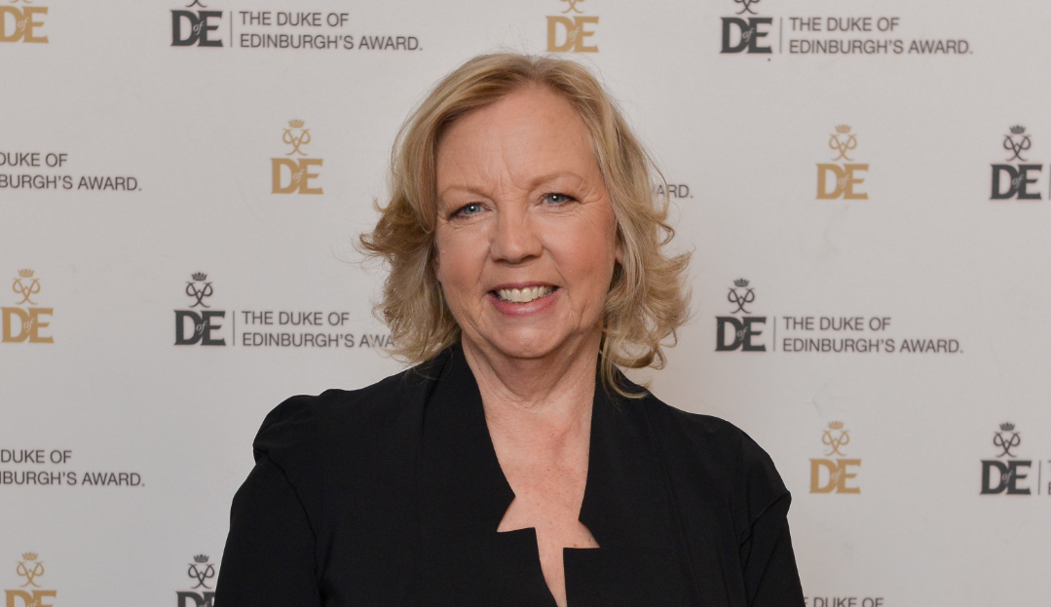
Why do your DofE?
GOLD
So why should you do your DofE? It’s hard to list all the benefits of achieving your Gold Award, so here’s a quick snapshot:
You’ll gain skills that employers’ value, which you can easily reference on your CV
Stand out from the crowd by highlighting activities that are related to your future career or studies in college, university and job applications
Get healthier and happier
Meet incredible people and make lasting friendships
Have amazing new experiences
Find talents you didn’t know you had
Become more confident and independent
Make memories that will last a lifetime
Have fun.
“As an actor I know how much Award holders’ experiences and the skills they’ve developed matter. Without determination and passion I wouldn’t be where I am today.”
Benedict Cumberbatch, actor.
“Life doesn’t naturally happen, you’ve got to get involved. What better way to do that than do your DofE. As an employer I want to work with people who have a range of skills and can see things through.”
Deborah Meaden, entrepreneur and Dragons’ Den investor

Slide 9
Start your DofE now
GOLD
Are you ready to volunteer, get fit, learn and go on expedition? The DofE is one amazing adventure you’ll never forget.
So, what are you waiting for?
To get started, complete the online registration form
(“Register for DofE” page on the College website).
If you have any questions, speak to Maisie Weller in room C5 or email mae@stbrn.ac.uk

